Slide 1
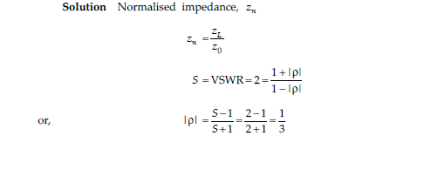
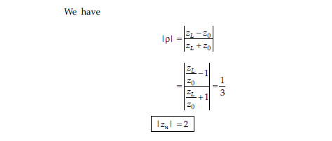
1. For a transmission line which is terminated in a normalized impedance Z_{n,} VSWR = 2. Then calculate the normalized impedance magnitude.

Slide 2
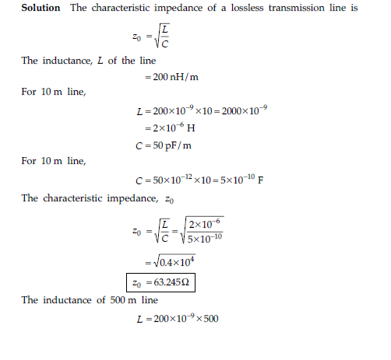
2. A lossless transmission line used in a TV receiver has a capacitance of 50pf/m and an inductance of 200 nH/m. Then calculate the characteristic impedance for the sections of a line 10 mete long and 500 meter long.

Slide 3
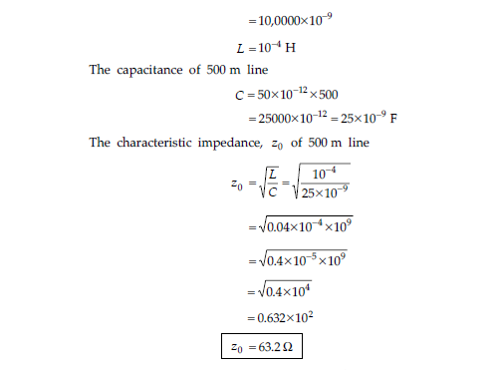

Slide 4
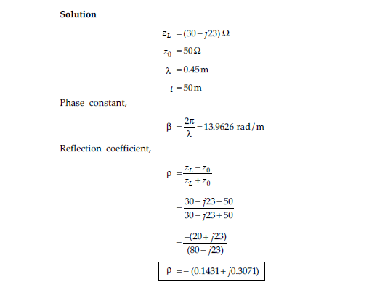
3. A lossless transmission line is terminated in a load impedance of 30-j23 ohms. Then by applying the concept of infinite line calculate the phase constant and the reflection coefficient of a line of length 50m, with characteristic impedance 50ohms and wavelength on the line is 0.45m.

Slide 5
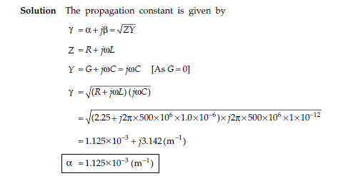
4. A lossy cable which has R =2.25 ohms/m, L=1 micro H /m, C= 1 peco F /m, and G=0 operates at a frequency of 0.5GHz. Then analyze the scenario and calculate attenuation constant of the line.

Slide 6
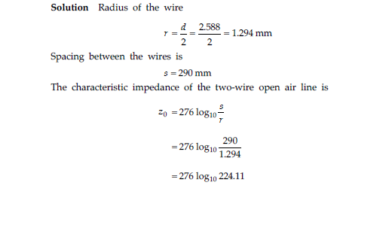
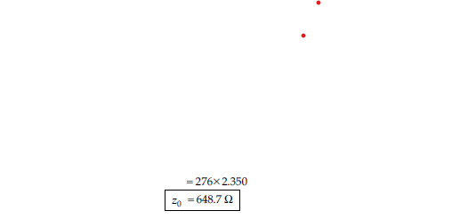
5. A two-wire open air line, whose diameter is 2.588mm is used in several applications. The wires are spaced at 290mm between the centers. Then calculate the characteristic impedance of the line.

Slide 7
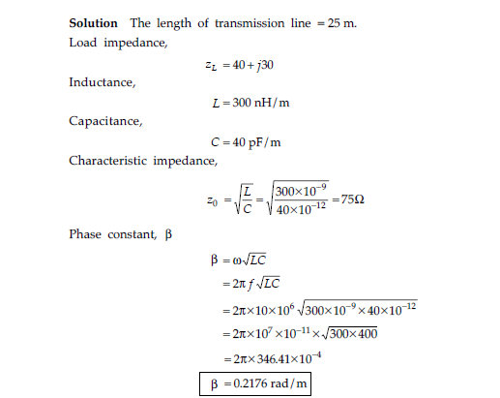
6. A transmission line is lossless and is 25m long. It is terminated in a load of 40+j30 ohms at a frequency of 10MHz. The inductance and capacitance of the line are L =300nH/m, C=40pF/m. Then calculate the input impedance at the source and at the midpoint of the line.

Slide 8
